Slide 1
Introduction to Biomass Energy Conversions

Slide 2
Outline
Introduction
Biomass as Renewable Energy Resources
Bioenergy production overview
Biomass to energy routes
Energy conversion systems
Conversion Technologies
Thermochemical Processes
Biochemical Processes
1
2

Slide 3
Introduction
Biomass as a renewable resource
Biomass is biological organic matter derived from living or recently-living organisms
Bioenergy is the energy contained (stored) in biomass
Biomass is an extremely important energy source, available nearly everywhere
Biomass encompasses a large variety of materials, including wood from various sources, agricultural and industrial residues, and animal and human waste
Two forms of biomass
Raw: forestry products, grasses, crops, animal manure, and aquatic products (seaweed)
Secondary: materials that undergone significant changes from raw biomass. Paper, cardboard, cotton, natural rubber
products, and used cooking oils.
4

Slide 4
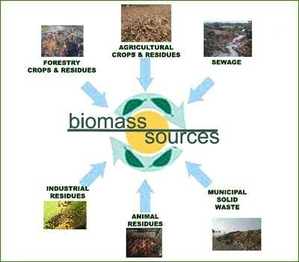
Introduction
Biomass as a renewable resource
5
6

Slide 5
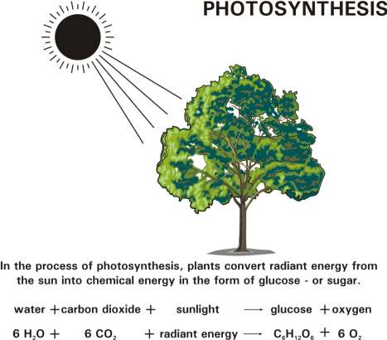
How Biomass gets its energy
6

Slide 6
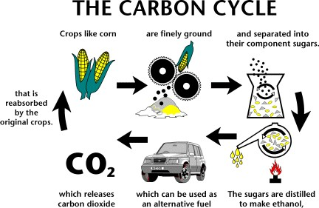
Example of Bioethanol Production
7

Slide 7
Bioenergy Production Overview
8
9

Slide 8
Bioenergy
Bioenergy is the energy retrieved from biomass sources. It is the largest used renewable energy resource in the world
Large bioenergy potential: Biomass resource is widely available and diversified in the Kingdom: Livestock waste, Municipal and Industrial effluents (paper, plastic, food, …etc.), Poultry waste, Sewage sludge
Bioenergy is a significant mean for waste disposal to prevent environmental pollution and allow economic stability
Main Technologies:
Biogas based power plant technology
Gasification power plant technology
Biodiesel and Bioethanol Plants technology
9

Slide 9
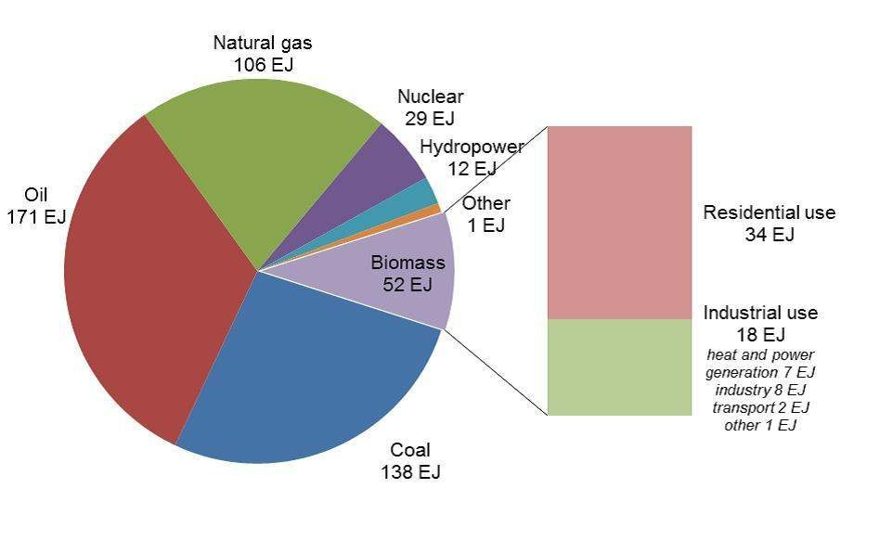
Biomass provides more than 10 % of Global energy use (International Energy Agency, 2013)

Slide 10
Bioenergy Production Routes
Combustion
Heat
Thermoche mical Platform
Pyrolysis
Char, Bio-oil Fuel gas
Gasification
Fuel gases (Syngas, H₂)
Combined heat & power, Fuels, Chemicals and materials
Anaerobic digestion
Biogas (methane)
Biomass Feedstock
Biochemical Platform
Fermentation
Bioethanol
Chemical Platform
Trans- esterification
Biodiesel

Slide 11
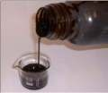
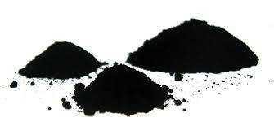
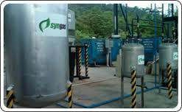
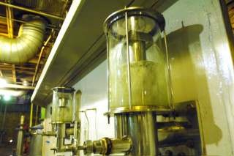
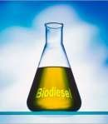
Pyrolysis products
Bio-oil
Char
Syngas
Bioethanol
Biodiesel
13
14

Slide 12
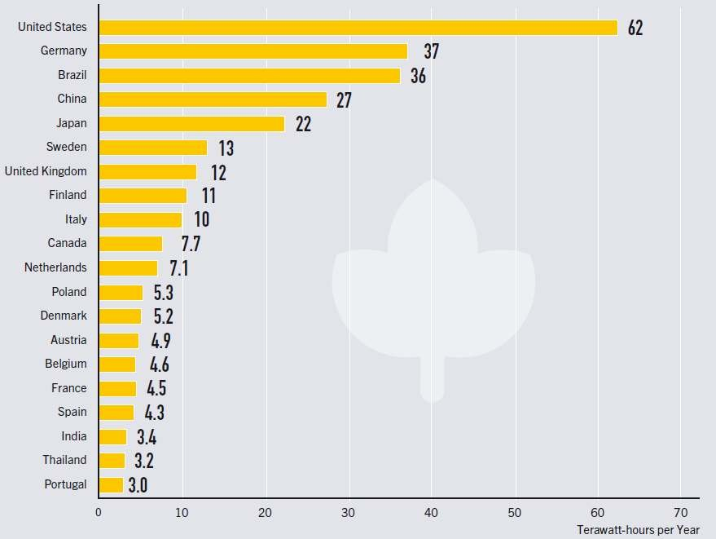
Bio-Power generation of top 20 countries for 2010-2012
(International Energy Agency, 2012)
15

Slide 13
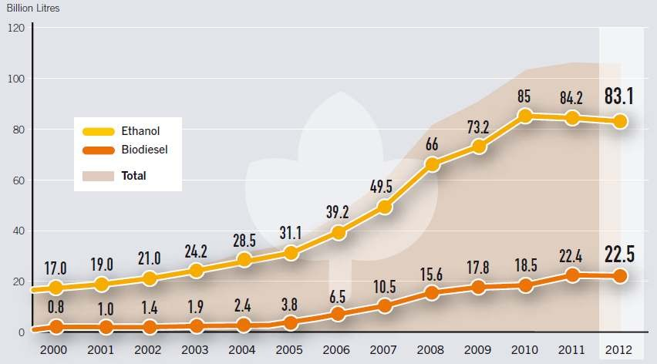
Global Production of Bioethanol and Biodiesel
(International Energy Agency, 2012)
16

Slide 14
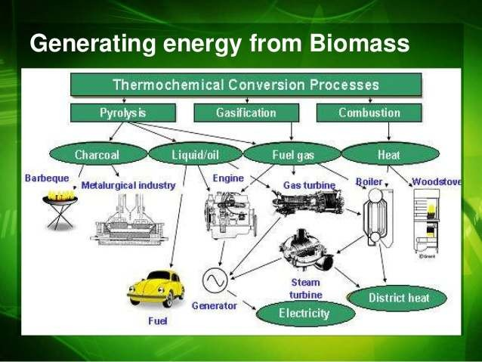
Energy generation systems
17

Slide 15
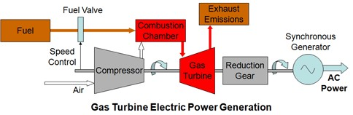
Energy generation systems

Slide 16
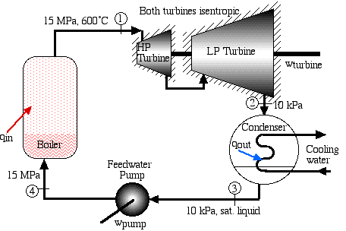
Energy generation systems
Steam turbine
19

Slide 17
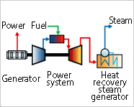
Energy generation systems
Combined heat & power system
20

Slide 18
Biomass Energy Conversions Technologies
1- Thermochemical processes

Slide 19
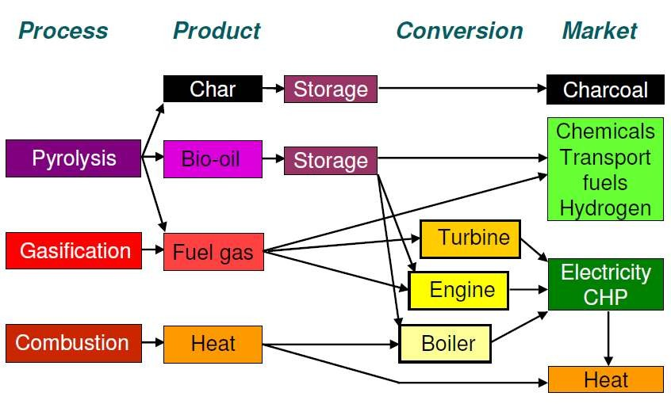
Thermochemical conversion options
22

Slide 20
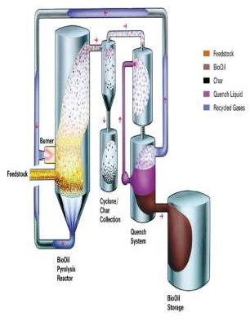
Pyrolysis
Thermal biomass oxygen
decomposition of solid
by heat in absence of
First step of in combustion and gasification processes
Biomass is converted into solid
charcoal, liquid (bio-oil) and gas
The process is endothermic
Because unavoidable system, a
some oxygen is in any pyrolysis small amount of
oxidation occurs
Dry Biomass € char + (CO, CO₂, H₂, H₂O (g), CH₄) + tars + Ash
22
23

Slide 21
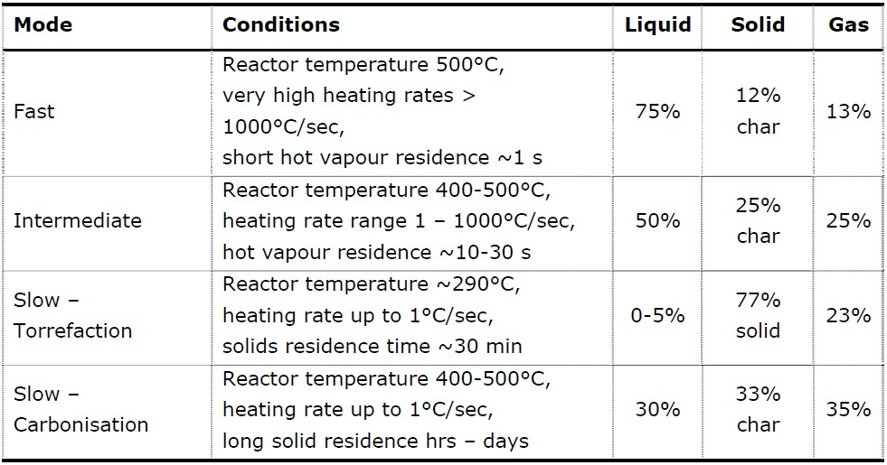
Pyrolysis
Classification of Pyrolysis methods
24

Slide 22
Typical Pyrolysis results
Temperature profile in standard Pyrolysis test
800
furnace temperature
charging
600
Temperature [ C]
o
mean bed temperature
400
200
furnace heating
carbonization
cooling
0
-20 -10
0 10 20 30 40 50 60
70 80 90 100 110 120 130 140
Time [min.]
25

Slide 23
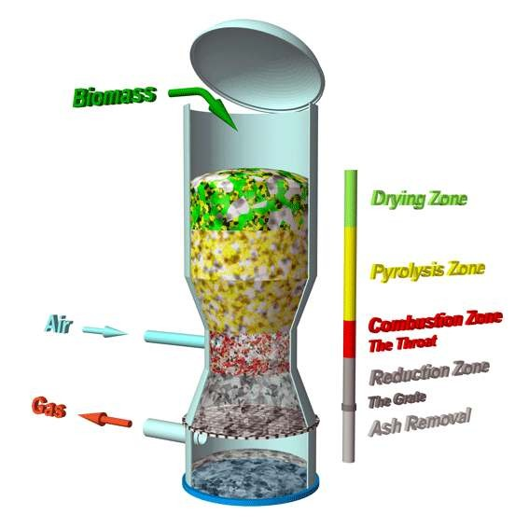
Gasification
Conversion of solid biomass into combustible gas mixture called producer gas (CO + H₂ + CH₄)
in presence of limited (O₂/air)
Involves partial combustion of biomass (controlled combustion)
Four distinct process in the gasifier
Basic Process Chemistry schematic
26

Slide 24
Gasification
Producer Gas Characteristics
Component | Rice Husk | Woody Biomass
CO | 15-20% | 15-20%
H₂ | 10-15% | 15-20%
CH₄ | Upto 4% | Upto 3%
N₂ | 45-55% | 45-50%
CO₂ | 8-12% | 8-12%
Gas C.V. (kcal/Nm³) | Above 1050 | Above 1100
Gas generated in Nm³/kg of biomass | 2 | 2.5

Slide 25
Gasification
Classification of Gasification methods
Classification | Conditional factor
Gasification pressure | Normal pressure (0.1-0.12 MPa), High pressure (0.5- 2.5 MPa)
Gasification temperature | Low (< 700 °C), High (> 700 °), High temperature decomposition (> ash fusion point)
Gasification agent | Air, oxygen, steam and combination of them, carbon dioxide for particular time
Heating (temperature zone formation) | Direct (heat generation from reaction of partial gasification raw material and oxygen) Indirect (external heat)
Gasifier types | Fixed bed, flow-bed, circulating flow bed, entrained bed, mixing bed, rotary kiln, twin tower, molten furnace

Slide 26
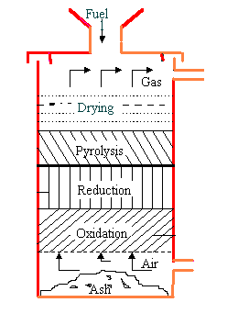
Gasifier types
Updraft Gasifier
+ Suitable for moderate outputs [2-12 MWe]
+ Good fuel flexibility [fines, small & large chips]
+ Good turndown
Low gas quality
Very high tars [100g/nm3] – requires extensive secondary tar cracking with catalysts [Ni based or
dolomite]
High capital cost
29

Slide 27
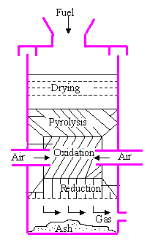
Gasifier types
Downdraft Gasifier
+ Very low tar gas [< 1 g/nm3]
+ Good gas CV [~5 MJ/nm3]
+ Simple gas train possible
+ Modular design
+ Simple construction and operation
Limited scalability [0.5 MWe~ 500 kg/h]
Precise fuel requirements [size, shape, moisture]
Engine costs can be high relative to other costs
Limited turndown
30

Slide 28
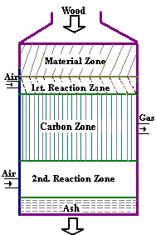
Gasifier types
Twin-fire Gasifier
+ Suitable for large electrical outputs [> 5- 10 MWe]
+ More flexible in use of steam, air, steam/O2 mix
+ High gas CV – 8-12 MJ/nm3
+ High overall electrical efficiencies [gas turbine use]
Complex design
Limited turndown
Stable operation difficult [DPs, gas flows]
High tar levels in gas – extensive cleaning/catalytic cracking required [Ni based
or dolomites].
Feed pretreatment to small particles
31

Slide 29
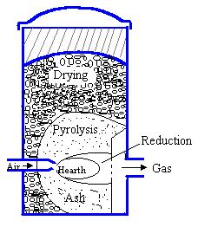
Gasifier types
Crossdraft Gasifier
+ Operable at very small scale (10kW and below)
Minimum tar conversion capabilitites
High exit gas velocity and temperature
32

Slide 30
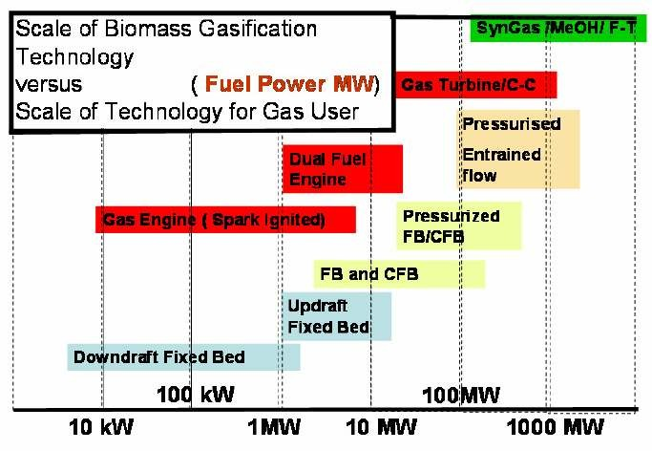
Gasification Technology scale output
33

Slide 31
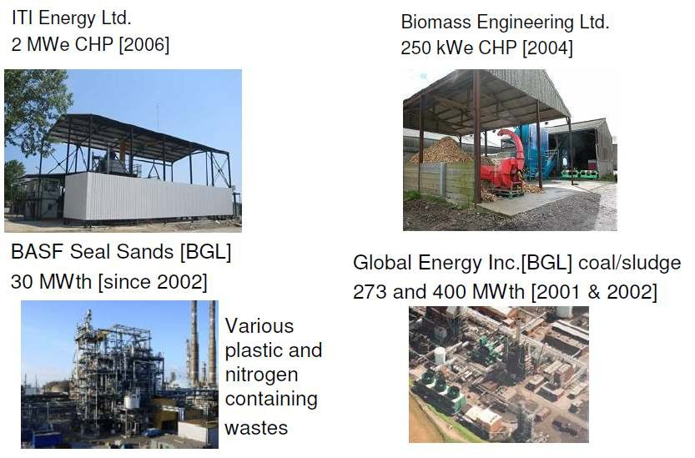
Example of gasification unit in UK
34

Slide 32
Biomass Energy Conversions Technologies
2- Biochemical processes

Slide 33
Anaerobic Digestion
AD is a series of biological processes in which microorganisms breakdown biodegradable material in the absence of oxygen
End product of the process:
Biogas: a mixture of CH₄ and CO₂ mainly which is combusted to generate electricity and/or heat or processed into renewable natural gas and transportation fuel
Digested solid: residue from the digester, can be composted and applied as land amendment or used for dairy bedding
Nutrients: residue from liquid digestate, used in agriculture as fertilizer
Various feedstock can be used:
Livestock manure, municipal wastewater solids, food waste, industrial wastewater and residuals, fats, and other organic waste streams

Slide 34
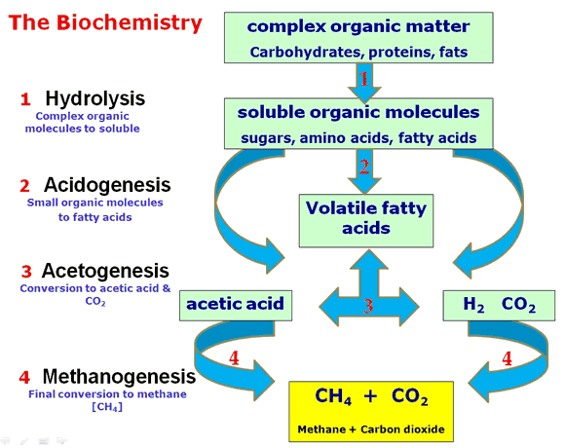
Anaerobic Digestion Principle
Initial hydrolysis of particulate matter and larger molecules
Fermentation (acidogenesis) (formation of acids) generating primarily acetate but also other Volatile Fatty Acids (VFA)
Acetogenesis (formation of acetate), Hydrogen is used as an electron acceptor
Methanogenesis Acetate € CO2+ CH4 (major pathway app. 70%) 4H2 + CO2 € CH4 + 2H2O
37

Slide 35
Anaerobic Digestion
Parameters and conditions influencing AD
Parameters | Optimal conditions
Total solid content (TS) | Low (<10 %) Medium (10-20 %) High (20-40%)
Temperature | Mesophilic (20-45 °C) Thermophilic (50-65 °C)
Retention time | 15-30 days for mesophilic 12-14 days for thermophilic
pH | Optimum between 6 – 7 Low pH inhibit acidogenesis stage High pH is toxic for methane forming bacteria
Carbon to Nitrogen ratio (C:N) | Optimum between 20 – 30 High C:N € rapid N consumption € lower gas production Low C:N € ammonia accumulation € toxicity
Organic loading rate (OLR) | High OLR € accumulation of inhibiting substances € low biogas yield
38

Slide 36
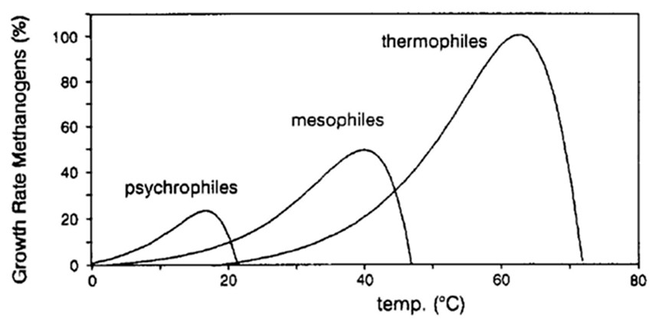
Anaerobic Digestion
Effect of operating temperature
39

Slide 37
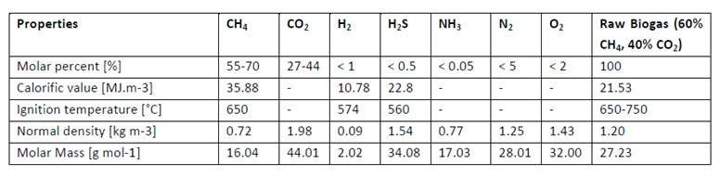
Anaerobic Digestion
Biogas properties
Biogas potential of some biomass substrate
Type of biomass | Biogas yield [m³/t]
Beef slurry | 25
Dairy waste | 55
Cuttings from beet | 75
Green waste | 110
Biowaste | 120
Fresh fat | 400
Old fat | 800
40

Slide 38
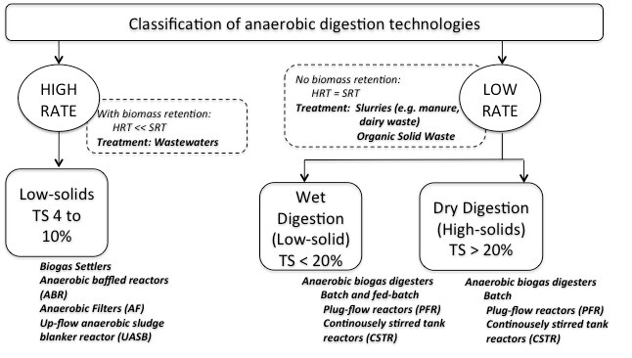
Anaerobic Digestion
Biogas properties
41

Slide 39
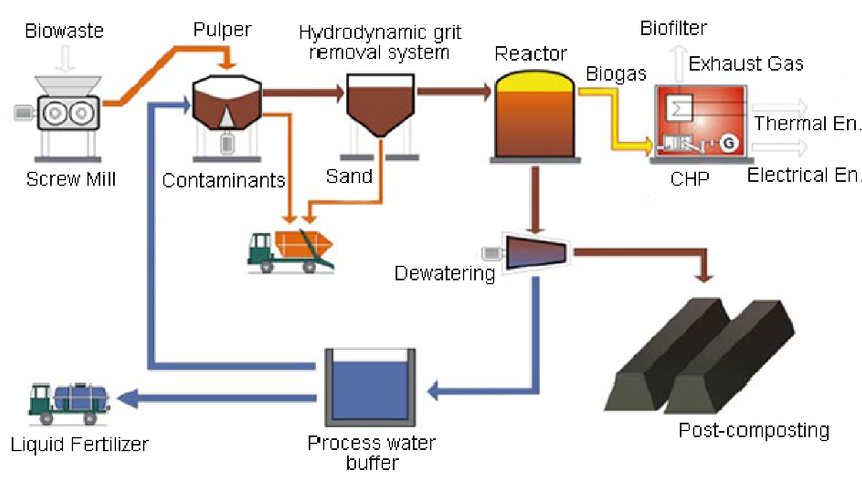
Anaerobic Digestion
Typical Biogas Power Plant
42

Slide 40
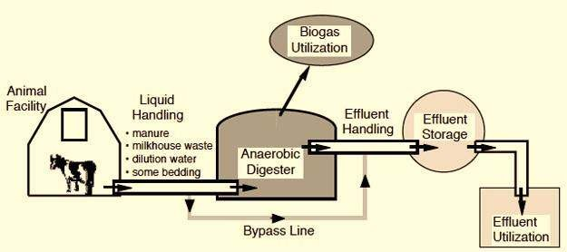
Anaerobic Digestion
Schematic of a typical agricultural AD system
43

Slide 41
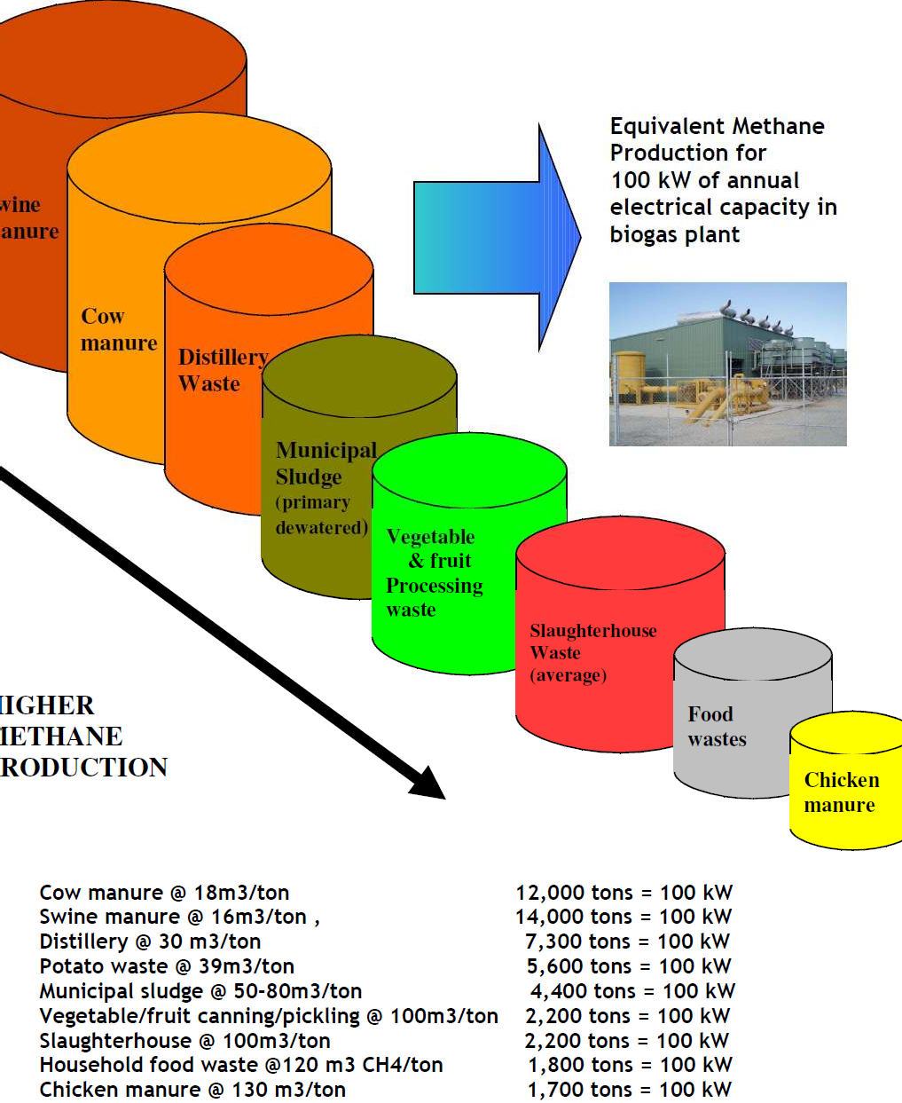
44

Slide 42
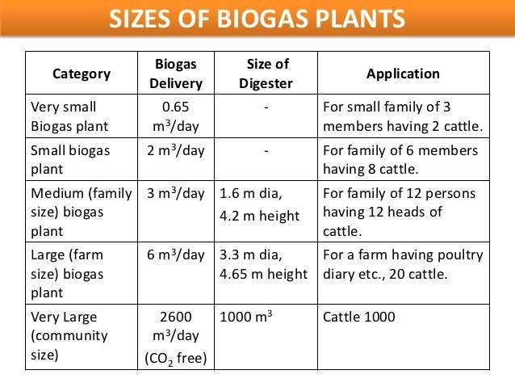
Anaerobic Digestion
45

Slide 43
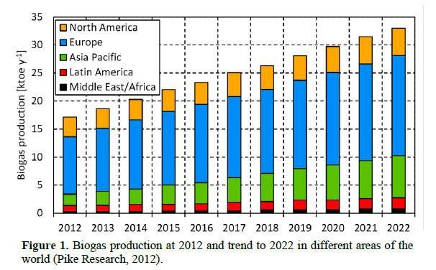
Anaerobic Digestion
Biogas Production at 2012 and trend to 2022 (Pike Research, 2012)
1 toe = 11.63 MWh
46

Slide 44
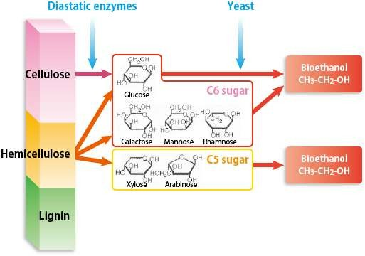
Fermentation
Bioethanol production process
47

Slide 45
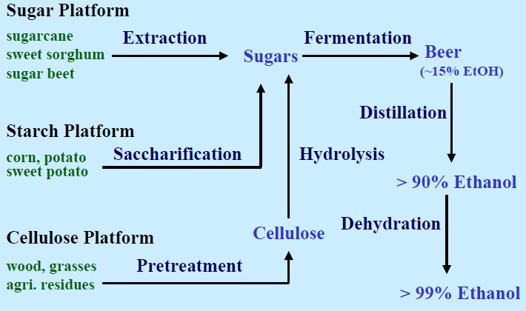
Fermentation
Bioethanol production flow diagram
Feedstock: corn, wheat, sugarcane, rice, potato, …
48

Slide 46
Conclusion
Biomass is a sustainable and reliable energy resource
The growth rate of biomass energy use is about 1 % each year
Technological barriers have to be overcame in order to promote the bioenergy development:
Upgrading the bio-fuel quality by extracting harmful species especially for biogas and syngas (ammonium, sulfur compounds, silicon based compounds, particulate, …)
Enhance the reaction mechanism for both AD and gasification processes

